Slide 1

Integrating narratives and visuals to communicate data effectively
Vanessa Vargas-Nguyen, PhD
Email: vvargas@umces.edu
Integration and Application Network
University of Maryland Center for Environmental Science
9 December 2021

Slide 2
Who
Why
How
What
Introduction
Rationale
Principles
Tools
Professional background
Integration and Application Network
Environmental intelligence
Environmental problem-solving
Science Communication
Narratives
Visuals
Data Visualization
Communication products
Report cards/Assessments

Slide 3
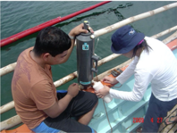
Sustainable future
Basic science and research
Marine and molecular scientist – HABS and microbiol communities
Environmental biotechnology

Slide 4

Environmental problems are social issues
Managing boundaries while creating information that is salient, credible and legitimate is required.
Communication and engagement strategies that are stakeholder-driven, and consider both scientific information and the human dimension is needed.

Slide 5


Sustainable future
Science communication and integration
Data visualization
Environmental decision-making
Basic science and research
Marine and molecular scientist – HABS and microbiol communities
Environmental biotechnology

Slide 6
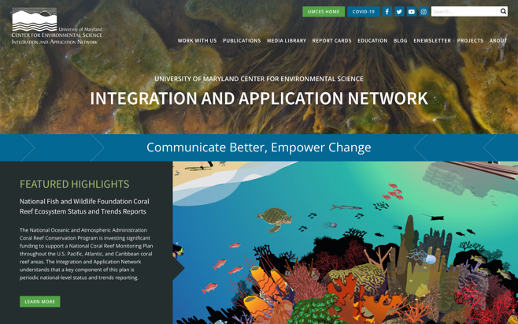
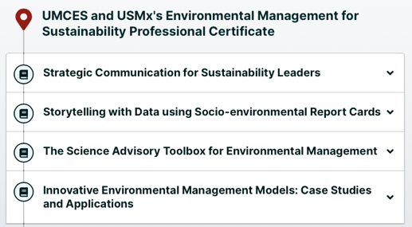
IAN is a boundary-spanning organization
IAN specializes in science communication and synthesis, socio-environmental report card development, stakeholder engagement, and capacity building

Slide 7
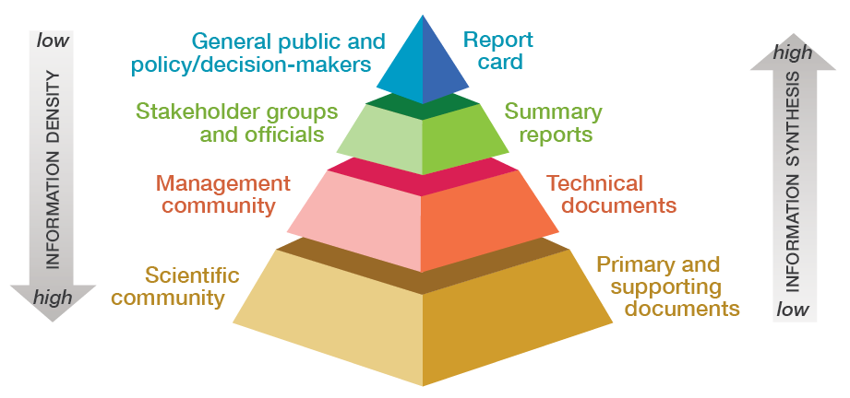
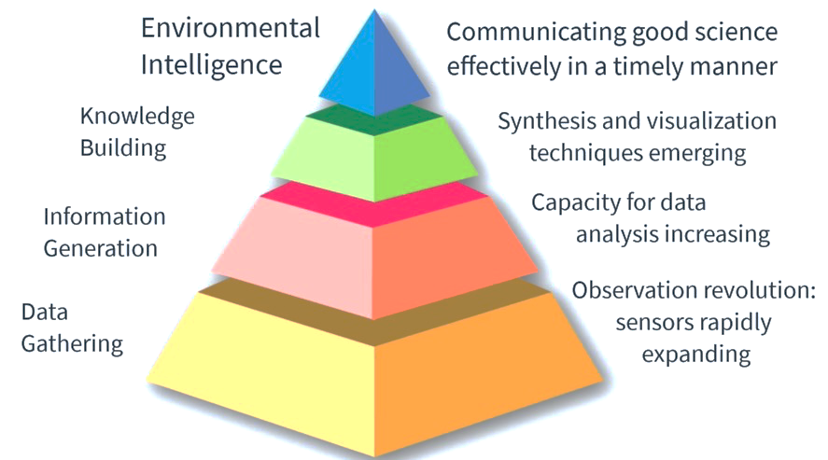
Developing environmental intelligence
https://ian.umces.edu

Slide 8
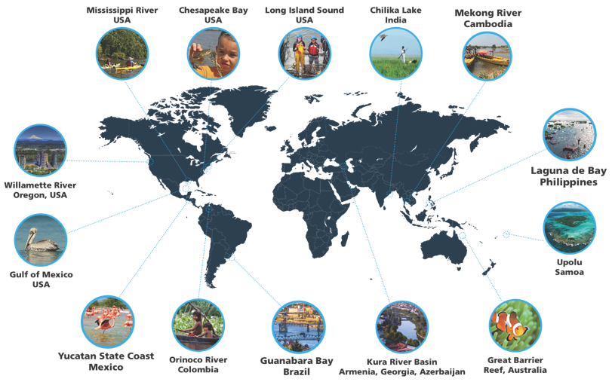
Report cards are increasingly being used
https://ian.umces.edu

Slide 9
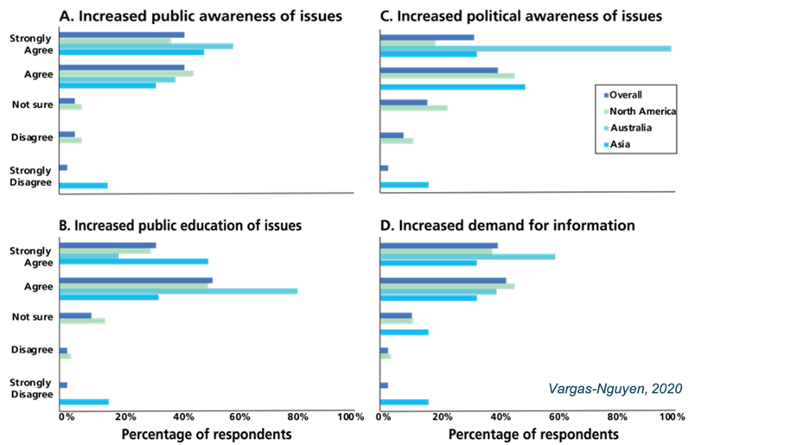
Report Cards increased environmental intelligence
Vargas-Nguyen, 2020

Slide 10

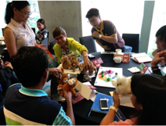

Sustainable future
Transdisciplinary approach
Socio-environmental synthesis
Stakeholder engagement
Science communication and integration
Data visualization
Environmental decision-making
Basic science and research
Marine and molecular scientist – HABS and microbiol communities
Environmental biotechnology

Slide 11
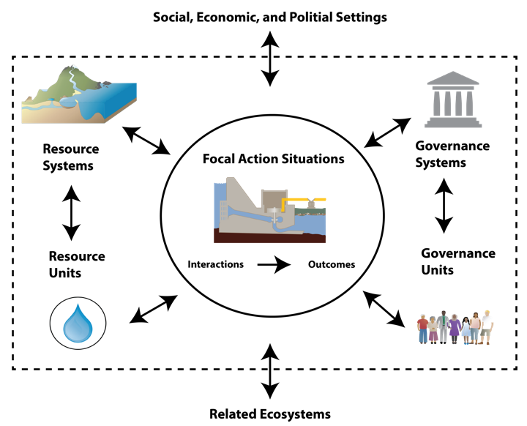
human dimension
Natural world
Communication and Engagement
Stakeholders
Revised SES framework adapted from McGinnis and Ostrom by V. Vargas-Nguyen

Slide 12
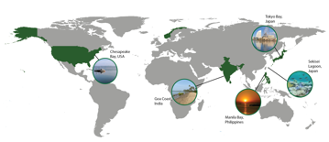


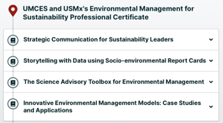
Sustainable future
Socio-environmental problem-solving
Teaching and capacity building
Socio-environmental governance
Transdisciplinary approach
Socio-environmental synthesis
Stakeholder engagement
Science communication and integration
Data visualization
Environmental decision-making
Basic science and research
Marine and molecular scientist – HABS and microbiol communities
Environmental biotechnology

Slide 13
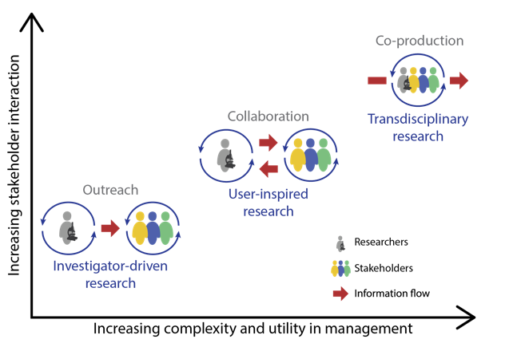
Socio-environmental problem-solving requires effective science communication
Douglas et al., in prep

Slide 14
What is science communication?
The practice of informing, educating, sharing wonderment, and raising awareness of science-related topics
(Wikipedia)

Slide 15
What is science communication?
The use of appropriate skills, media, activities and dialogue to produce awareness, enjoyment, interest, opinion-forming and/or understanding of science
(Burns et al., 2003, Science communication: A contemporary definition, Public Understand. Sci 12: 183-202)

Slide 16
What is science communication?
The successful dissemination of knowledge with a wide range of audiences, including non-scientists
(Integration and Application Network)

Slide 17

The most important goal in communicating science is . . .

Slide 18
The most important goal in communicating science is . . .
Effectiveness

Slide 19
Ask yourself:
WHO am I communicating with?

Slide 20
We need to stop asking:
“What do
I want to say?”
And start asking ourselves ...

Slide 21
We need to stop asking:
“What do I want to say?”
And start asking ourselves ...
“What do I need my audience to learn?”

Slide 22
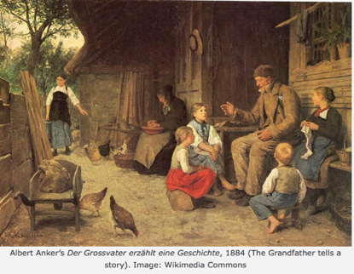
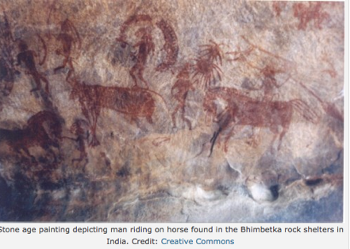
Storytelling and visualizations are the most ancient forms of human communication

Slide 23
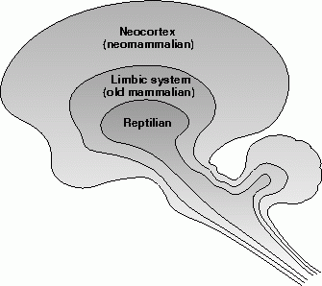
... and our brains are hardwired to respond to stories and to visualizations
Thinking brain (neocortex)
Emotional brain (limbic system):
emotion, behavior, motivation,
long-term memory
Thinking brain (neocortex):
Sensory perception, cognition,
spatial reasoning, language
Emotional brain (limbic system)
Brain layers, CC BY-SA 4.0

Slide 24
Using ‘why’ and ‘what’
‘Why’ addresses motivation & emotional content and goes to long-term memory [limbic system]
‘What’ addresses the cognitive & rational basis of an argument [neocortex]

Slide 25
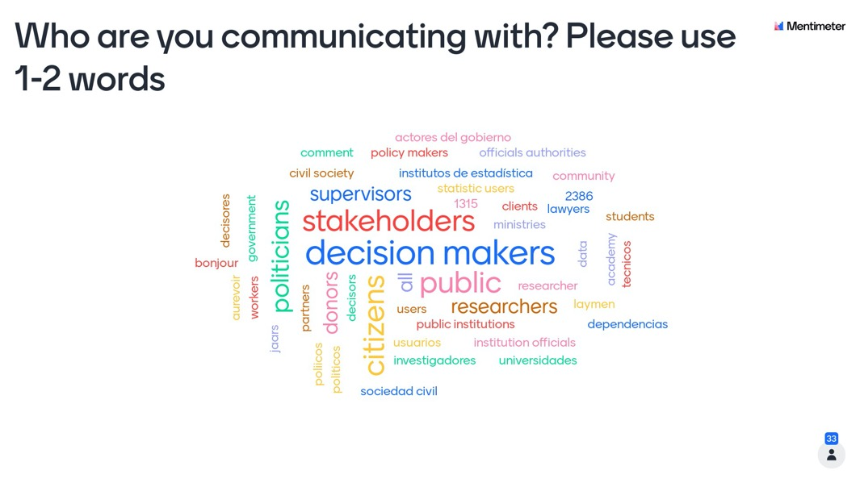

Slide 26
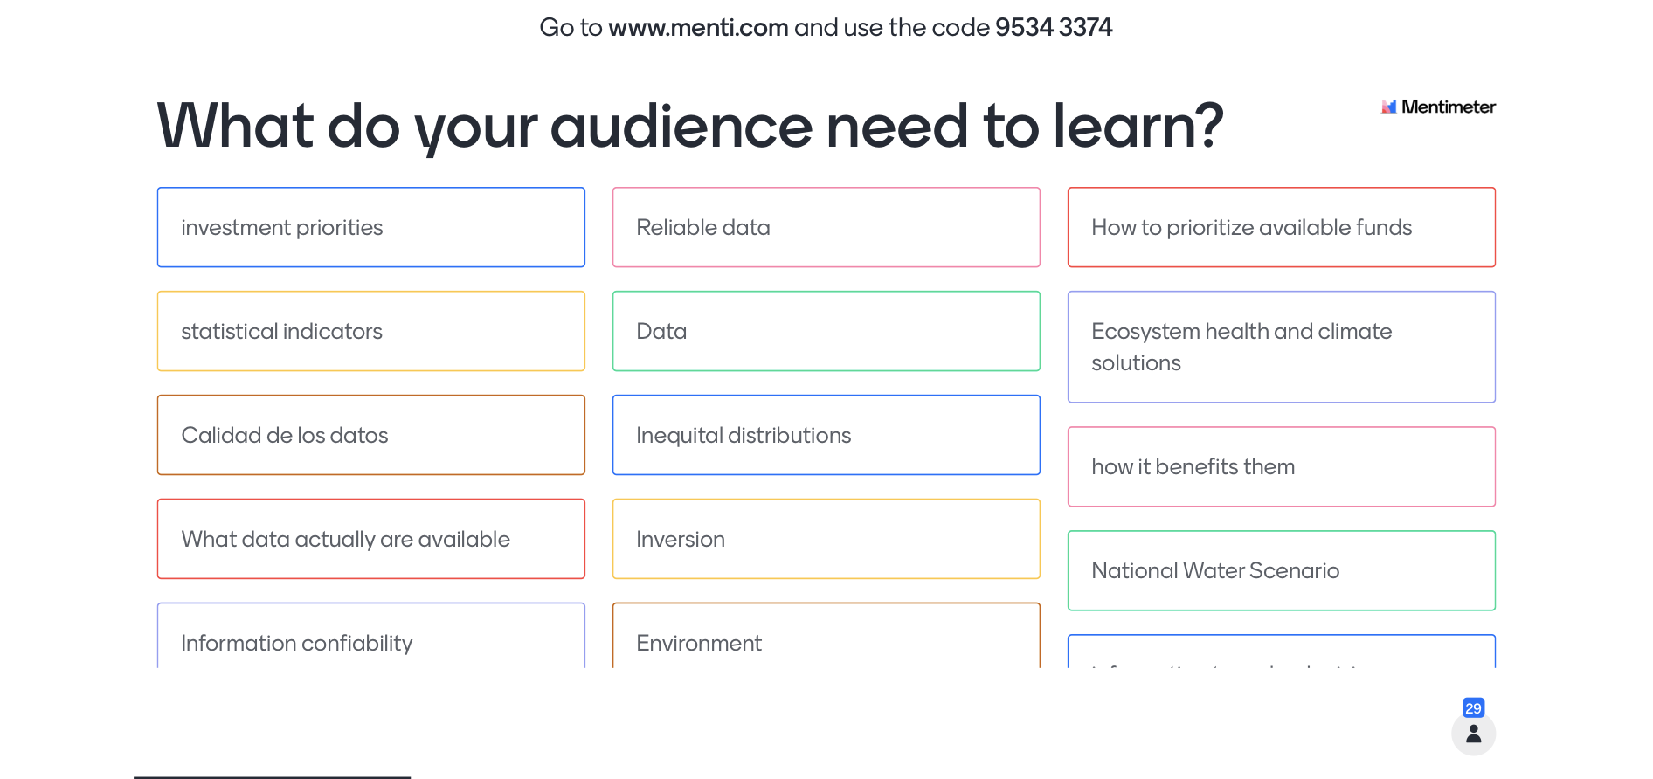

Slide 27
Science communication basics
Science communication = successful dissemination, wide range of audiences
Goal = Effectiveness
Ask ourselves “What do I need my audience to learn?”
Human brains are hardwired for visuals and story; answer ‘Why’ and ‘What’

Slide 28




Using narrative in science communication
Context is key: Address WHY your audience should care
Active titles help guide the audience and link with visuals
ABT
Narrative structure should follow the ABT (…and …but …therefore…) template
Storytelling using cause/effect, a timeline and people can be a powerful tool
Simplify and define terms, avoid jargon but do NOT ‘dumb it down’ – instead, ‘raise the bar’

Slide 29

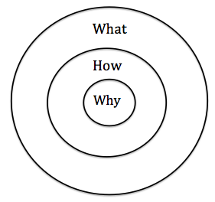
Context is key: Address WHY your audience should care

Slide 30


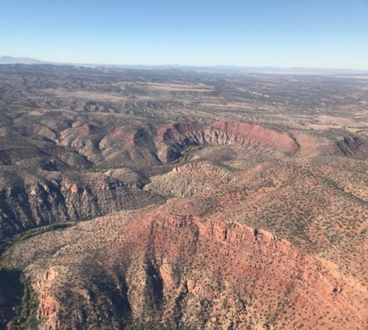
Context is key: Address WHY your audience should care

Slide 31

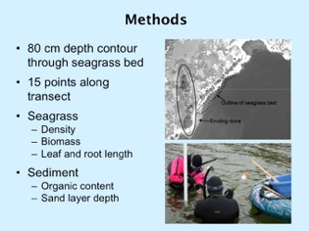
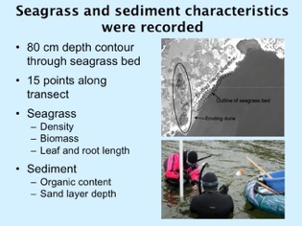
Active titles help guide the audience and link with visuals
Active titles are short declarative statements that summarize key messages
Active titles should stand alone
Use verbs that describe the results of a graph, map, or figure
https://ian.umces.edu

Slide 32
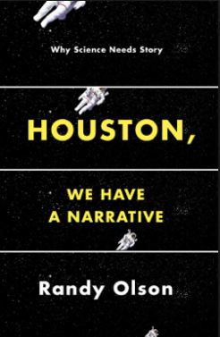
Narrative structure should follow the
ABT (... and ... but ... therefore ...) template
ABT
AAA . . .and . . . and . . . and . . .
DHY . . . despite . . . however . . . yet . . .
ABT . . . and . . . but . . . therefore. . .
ABT structure provides agreement, contradiction and consequences

Slide 33
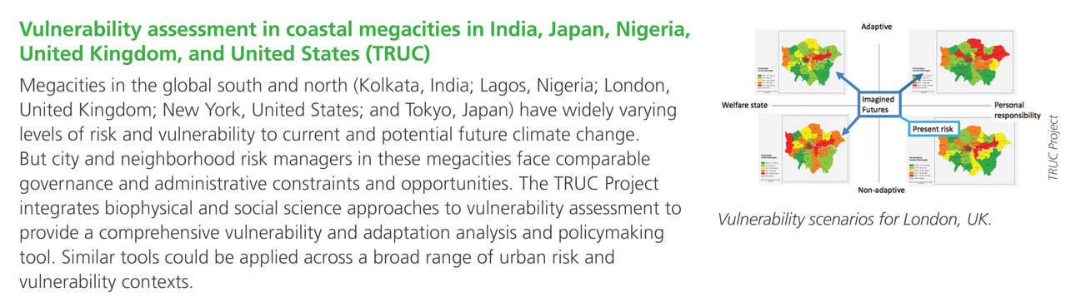
ABT
Narrative structure should follow the
ABT (... and ... but ... therefore ...) template
Researchers and stakeholders address coastal vulnerability and freshwater security, IAN Press

Slide 34
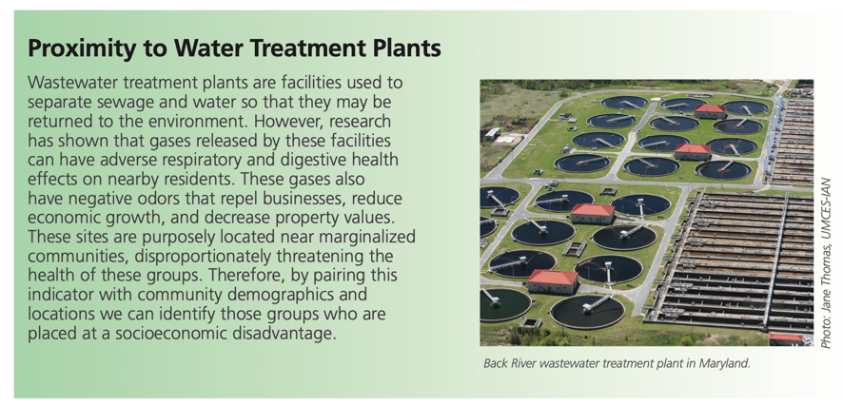
Narrative structure should follow the
ABT (... and ... but ... therefore ...) template
ABT
Developing a framework for an Environmental Justice Index in the Chesapeake Bay watershed, IAN Press

Slide 35

Storytelling can be a powerful tool
Cause/effect: Things that happen lead to other things that happen
Timeline: First this happened, and then that happened
People: People involved in the story
Relevance: Connect to your audience

Slide 36
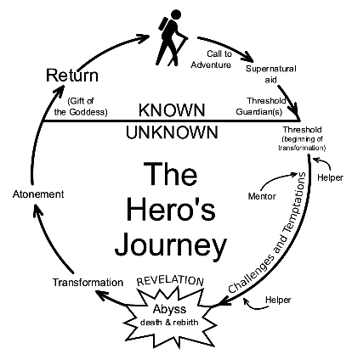
Storytelling can be a powerful tool
Cause/effect: Things that happen lead to other things that happen
Timeline: First this happened, and then that happened
People: People involved in the story
Relevance: Connect to your audience
Illustration of the hero's journey, Public Domain

Slide 37
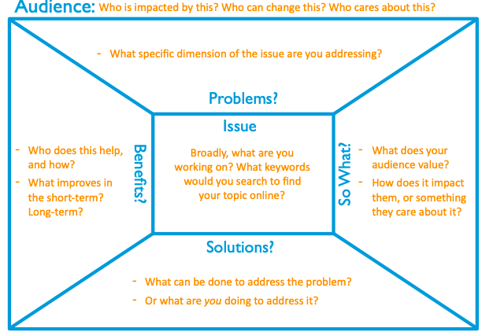
Storytelling can be a powerful tool
Message box
https://www.compassscicomm.org/

Slide 38
Not possible to show original content

Slide 39
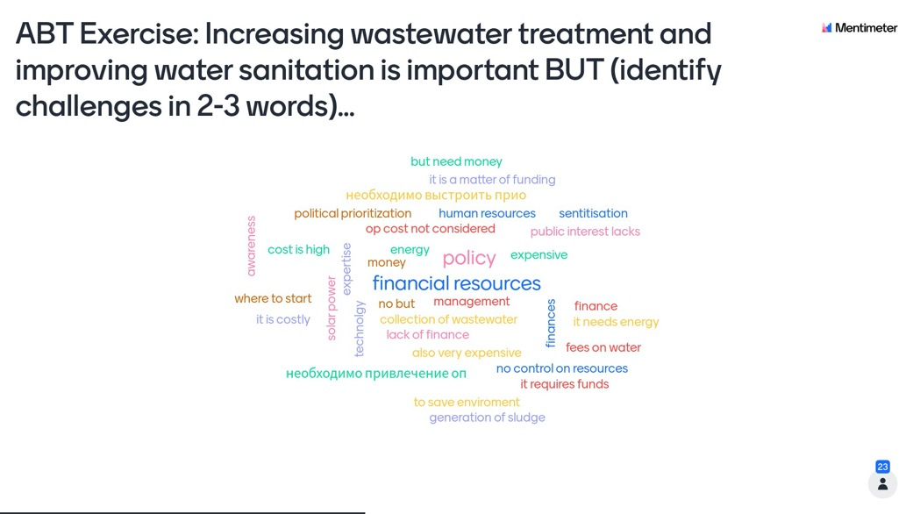

Slide 40
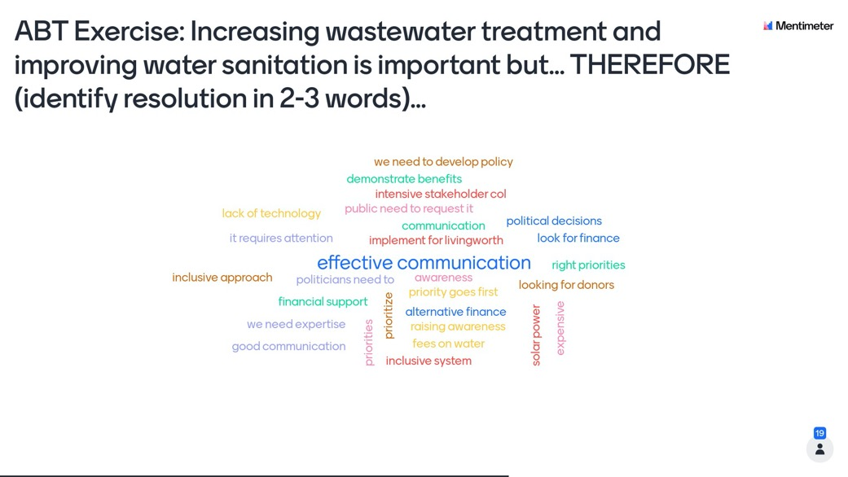

Slide 41
Using narrative in science communication
Context is key: Address WHY your audience should care
Active titles help guide the audience and link with visuals
ABT
Narrative structure should follow the ABT (…and …but …therefore…) template
Storytelling using cause/effect, a timeline and people can be a powerful tool
Simplify and define terms, avoid jargon but do NOT ‘dumb it down’ – instead, ‘raise the bar’

Slide 42
Using visuals in science communication
Diversity of visual elements enhances science communication
Eliminate extraneous information, e.g., ‘chart junk’, ’map clutter’
Cognitive response to visuals is an important consideration
Self contained visuals with supporting information preferred
Visuals need to be fully integrated with text

Slide 43
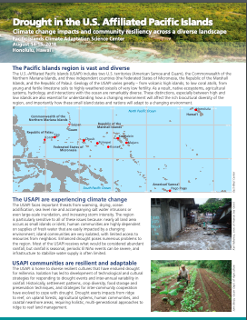
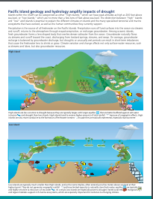
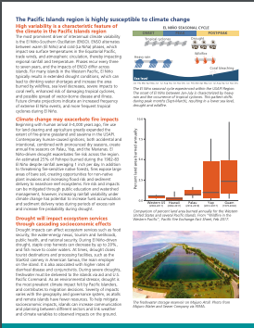
Diversity of visual elements enhances science communication
Infographic
Map
Graph
Diagrams
Map
Photos
Photo
Drought in the US Affiliated Pacific Islands, IAN Press

Slide 44
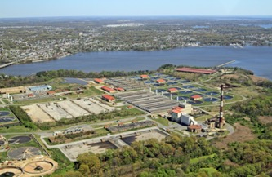
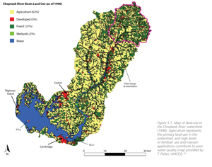
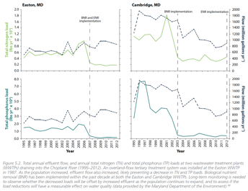
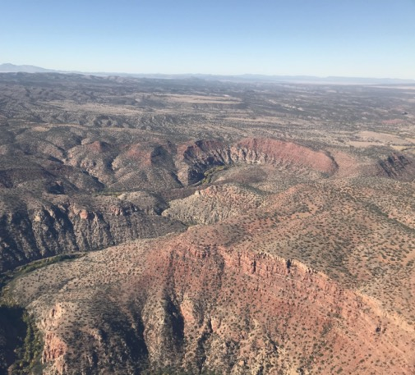
Many different forms of visuals
Photograph
Maps
Graphs
Back River Waste Water Treatment Plant, Baltimore Maryland
Jonathan Kellogg, CC BY-SA 4.0
New Insights: Science-based evidence of water quality improvements, challenges, and opportunities in the Chesapeake, 2004
https://ian.umces.edu

Slide 45
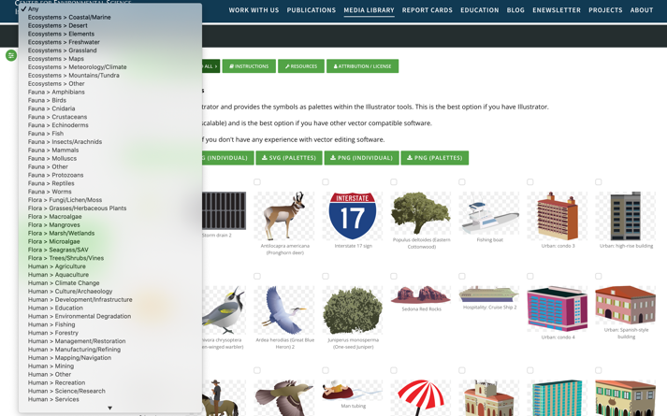
Many different forms of visuals
Symbols are easily recognized and information rich
Symbols are language independent and universal
Symbols can represent
something tangible
Symbols can represent something invisible or intangible
IAN symbol library
https://ian.umces.edu/media-library/symbols/

Slide 46
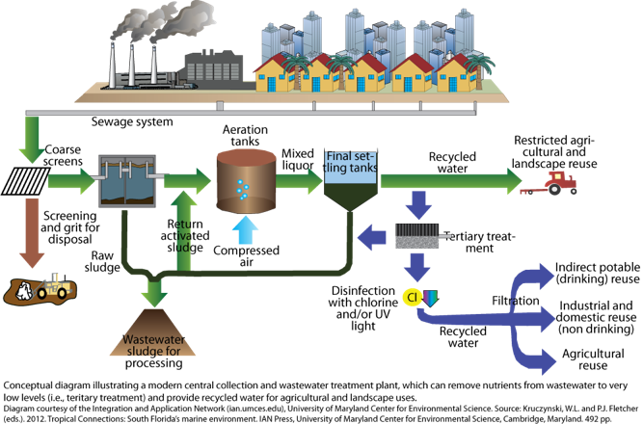
Many different forms of visuals
A conceptual diagram is a “thought drawing” that can be used to communicate complicated processes and environmental concepts in a simple and easy to digest format.
Kris Beckert, CC BY-SA 4.0
(ian.umces.edu/media-library)
https://ian.umces.edu

Slide 47
Not possible to show original content

Slide 48
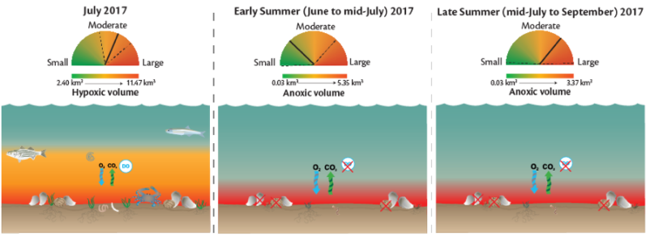
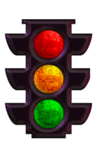
Cognitive response to visuals is an important consideration
Stoplight colors used to indicate risk
https://ian.umces.edu

Slide 49
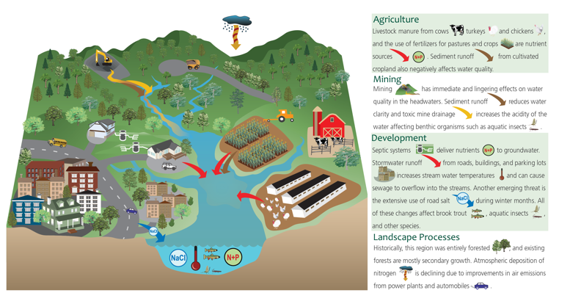
Self contained visuals with supporting information preferred
Upper Potomac River Watershed Report Card, IAN Press

Slide 50

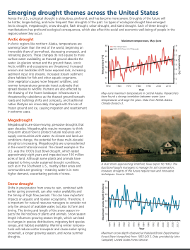
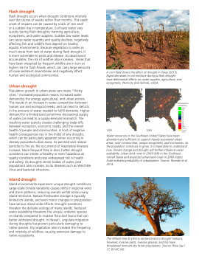
Visuals need to be fully integrated with text
Ecological drought across the United States, IAN Press

Slide 51
Not possible to show original content

Slide 52
Using visuals in science communication
Diversity of visual elements enhances science communication
Eliminate extraneous information, e.g., ‘chart junk’, ’map clutter’
Cognitive response to visuals is an important consideration
Self contained visuals with supporting information preferred
Visuals need to be fully integrated with text

Slide 53
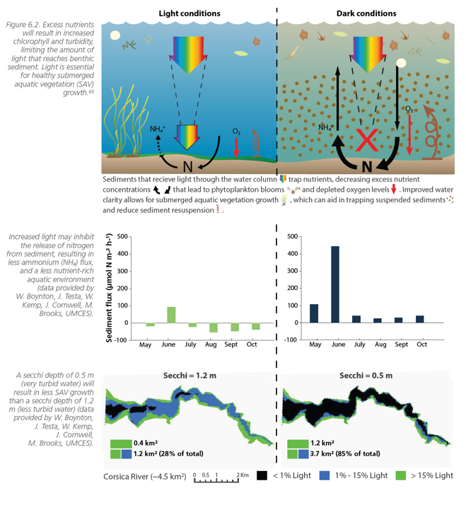
Data visualizations
Gain understanding
Aid in data analysis
Communicate information
Transform the invisible to the visible
Guide research and funding
https://ian.umces.edu

Slide 54
Not possible to show original content

Slide 55
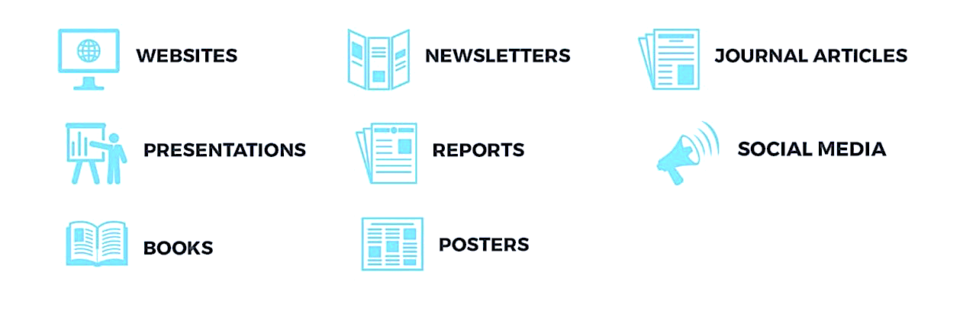
Science communication products

Slide 56
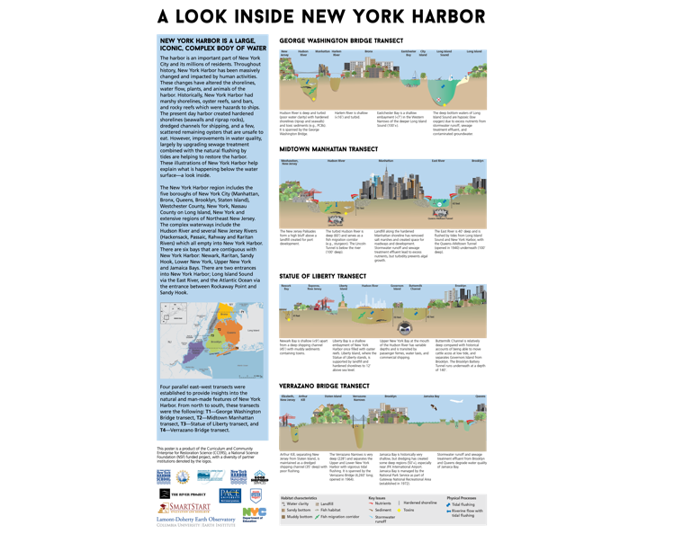
Posters
Advantages:
  Potentially reaching a large audience
  Remain displayed for longer period of time
Challenges:
  Expensive to print
  Difficult to transport
  Time-intensive
A look inside New York Harbor, IAN Press

Slide 57

Newsletters and factsheets
Advantages:
  Quick to produce
  Easy for broad audience to consume
Challenges:
  Limited space availability
  Can be viewed as marketing tool
Evaluating Transdisciplinary Approaches, IAN Press

Slide 58
Report cards are effective communication tools
https://ian.umces.edu

Slide 59
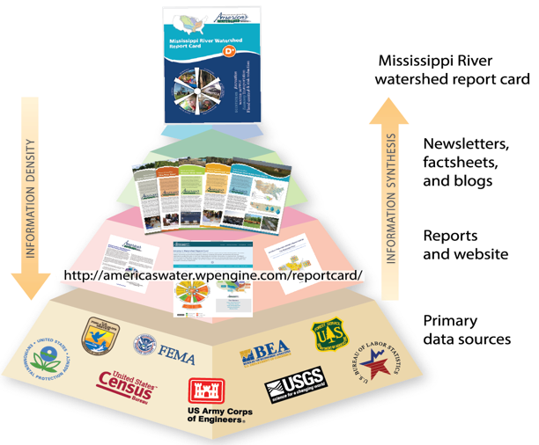
The Mississippi River Watershed Report card was built with transparency
Vargas-Nguyen et al, 2020

Slide 60
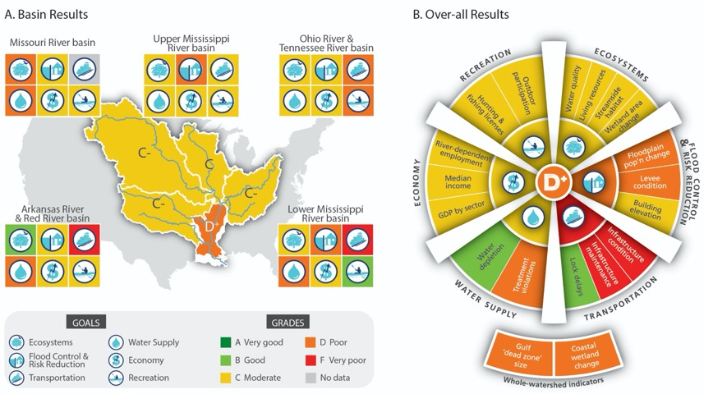
Information was synthesized and knowledge gaps were identified
Vargas-Nguyen et al., 2020

Slide 61
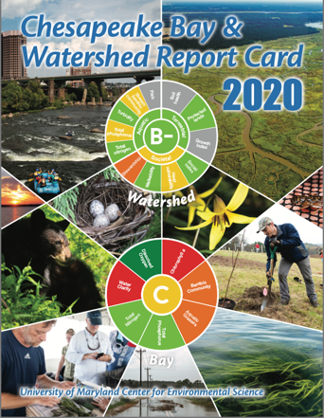
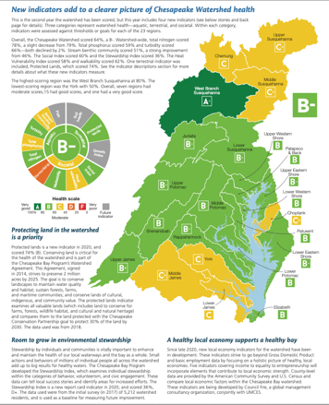
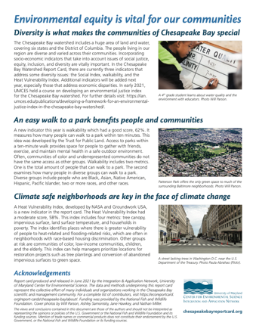
Chesapeake Bay Watershed Report Card released (June 22, 2021) – 193 Million media impressions
Chesapeake Bay and watershed report card 2020, IAN Press

Slide 62


Developing a framework for an Environmental Justice Index in the Chesapeake Bay watershed, IAN Press

Slide 63


Developing a framework for an Environmental Justice Index in the Chesapeake Bay watershed, IAN Press

Slide 64


Developing a framework for an Environmental Justice Index in the Chesapeake Bay watershed, IAN Press

Slide 65


Slide 66


Slide 67
Important points to remember:
Developing environmental intelligence and solving environmental problems requires effective communication and engagement
Science communication is successful dissemination of knowledge to a wide range of audiences including non-scientists.
Effective science communication uses storytelling, context, visualizations, and synthesis.
Science communication could be done in a variety of ways

Slide 68









THANK YOU!!!
For more information: vvargas@umces.edu
https://ian.umces.edu
https://www.edx.org/

Slide 69
Resources
Integration and Application Network - https://ian.umces.edu/
Vargas-Nguyen 2020. The role of socio-environmental report cards in transdisciplinary collaboration and adaptive governance for a sustainable future. Dissertation. https://drum.lib.umd.edu/handle/1903/26265
Vargas-Nguyen et al 2020. Using socio‐environmental report cards as a tool for transdisciplinary collaboration. https://doi.org/10.1002/ieam.4243
Developing a framework for an Environmental Justice Index in the Chesapeake Bay watershed, IAN Press
Massive Open Online Courses – edX
Strategic Communication for Sustainability Leaders
Storytelling with Data using Socio-environmental Report Cards
The Science Advisory Toolbox for Environmental Management
Innovative Environmental Management Models: Case Studies and Applications

